Slide 1



call center
View in Power BI
Last data refresh:
11/25/2023 6:54:49 AM UTC
Downloaded at:
11/25/2023 7:08:12 AM UTC

Slide 2
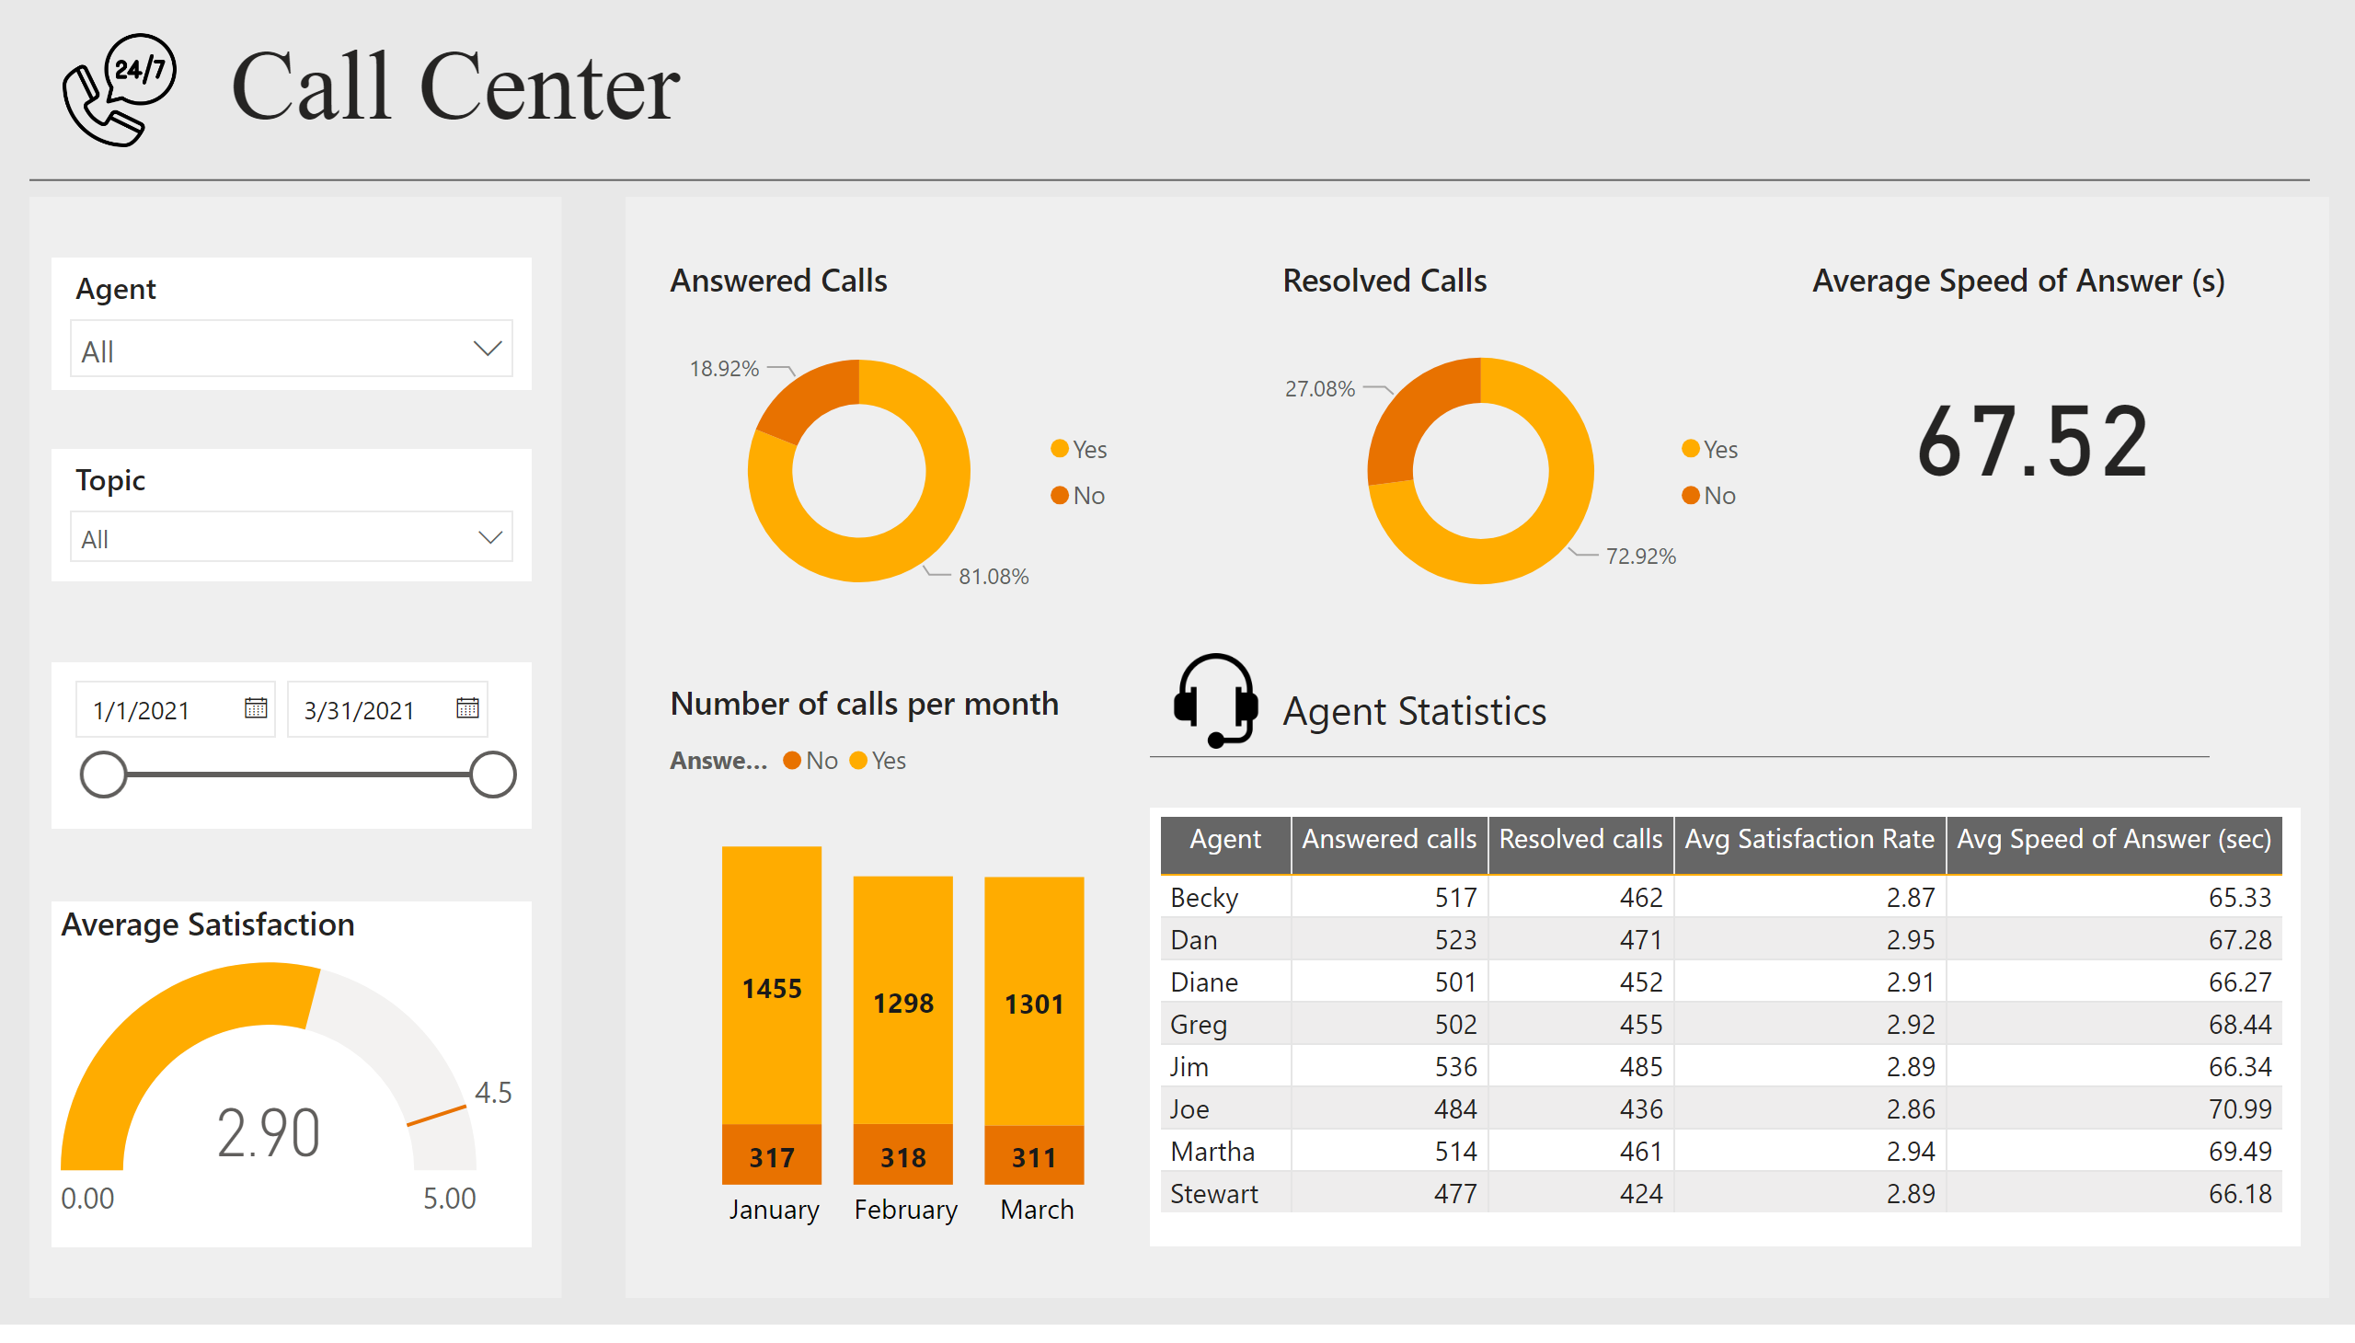
Report
Notes:
image
No alt text provided
textbox
No alt text provided
slicer
No alt text provided
Average Satisfaction
No alt text provided
slicer
No alt text provided
slicer
No alt text provided
Answered Calls
No alt text provided
Resolved Calls
No alt text provided
Average Speed of Answer (s)
No alt text provided
shape
No alt text provided
shape
No alt text provided
shape
No alt text provided
Number of calls per month
No alt text provided
tableEx
No alt text provided
textbox
No alt text provided
shape
No alt text provided
image
No alt text provided

